Slide 1
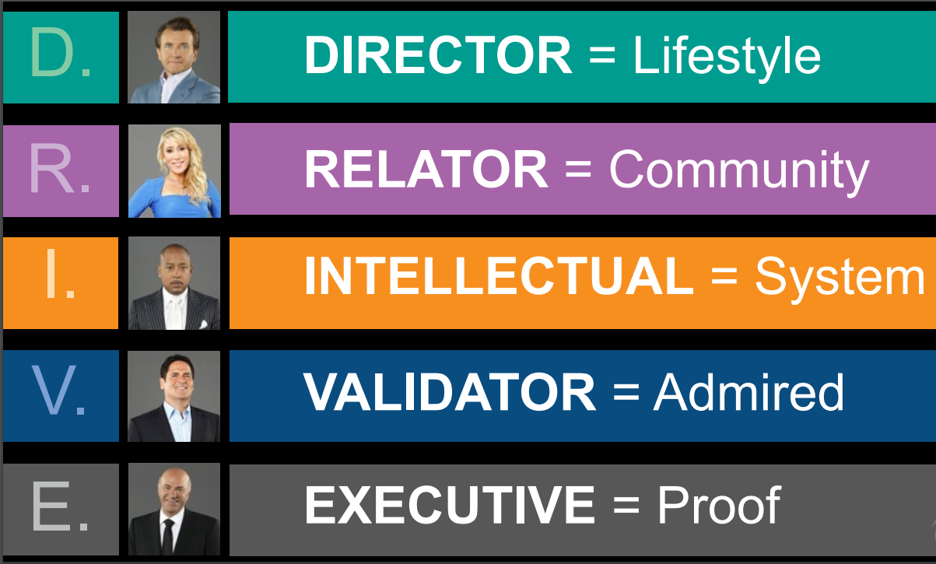
Notes:
In order to help people, we need to understand their language
D.R.I.V.E. System –There are five buying personalities that DRIVE someone to want to join: Directors, Relators, Intellectuals, Validators, and Executives.
READ THE 5 DRIVE – SHARK TANK CAST
***Mary has said on numerous occasion, WE MUST LEAD WITH THE COOPERATIVE. We know a lot of people are attracted to The Eden Project TE and especially now since we have The Gathering. You want to make sure you are bringing on likeminded individuals who can carry their weight by sharing, inviting and Onboard their people or you will be stuck like Chuck doing everything for them.
In order to help someone, you need to know their language and what DRIVEs them to make decisions according to their personality and viewpoint.
Do you feel when you are explaining something to someone and it seems as if they are not connecting? Maybe you are not speaking their language.
You speak your one language, which is 20%. The 20/80 rule states, you lose 80% of the people you share a concept with because you don’t modify your language to speak the other person’s language.
When you master the other four buying personalities, it has the potential to increase your ability to close by 400%.
The system guide is in the back office you can print. Also, 25 minute video teaching by Woody in TE Announcement Channel for your viewing.
D.R.I.V.E. SALES book by Woody Woodward
NEXT SLIDE

Slide 2





D.R.I.V.E. Assessment
D
R
INSTRUCTIONS
Read Each Card First
Rank The D.R.I.V.E. Cards based on the card with the most words that MAKES YOU FEEL IMPORTANT, not what is important to you.
Example: R, E, D, I, V
Experiencing Life
Life’s Purpose
Freedom
Creativity
Performing
Overcoming
Appearance
Relationships
Influence
Service
Family
Friends
Parent
Spirituality
© 2020 - Woody Woodward
I
V
E
Knowledge
Learning
Health
Nature
Moment
Standards
Organized
Recognition
Accepted
Praise
Trust
Respect
Validation
Being Needed
Winning
Control
Work
Goals
Security
Providing
Problem Solving
Notes:
INSTRUCTIONS
Read Each Card First (READ OUTLOUD)
Rank The D.R.I.V.E. Cards based on the card with the most words that MAKES YOU FEEL IMPORTANT, not what is important to you.
Example: R, E, D, I, V
The primary DRIVE is why you do what you do (your motive)
The secondary DRIVE is how you go about it (your process)
PUT YOUR 1ST and 2nd DRIVE in the chat if you choose to do so.

Slide 3
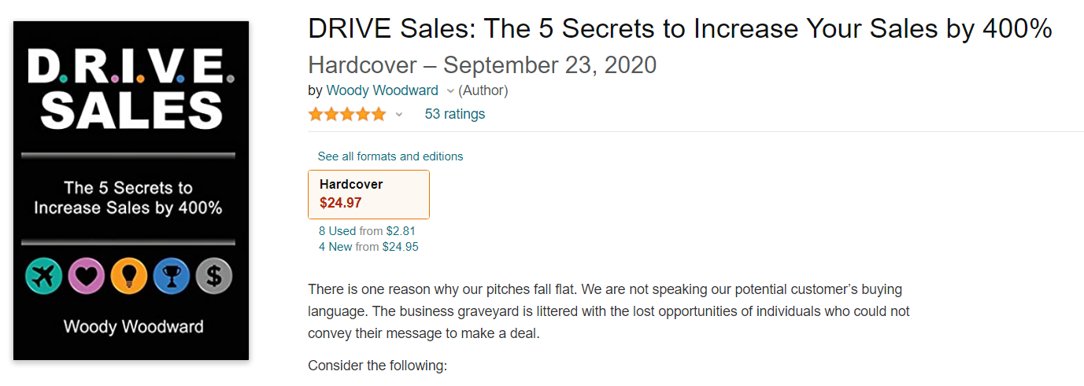

Slide 4


4.
5.
2.
Attend a Presentation
*Create a tracking system
Follow-Up Call or Text
Ask qualifying questions
Answer their questions
*Reiterate their Why, Purpose/Passion, Vision in Life?
Make Contact
Call, Text, Email, social media
*FORM > D.R.I.V.E.
*Identify their Why, Purpose/Passion,
Vision in Life?
3.
1.
Invitation
Send link for
virtual presentation
*Send BCPC Promo video
http://bit.ly/BCPCPROMO
Referrals
100 Names
*Memory Jogger
-----------------------------------
The Promised Land
STRAIGHT LINE SYSTEM
-----------------------------------
8.
Register for Eden Project
Trinity Elite Strategy
*Team Diane
*Team Drea
*Team Owerri
*Team Ty
10.
6.
Stay Connected!
INVITE!
INVITE!
INVITE!
Get a Commitment
Join BCE Membership
9.
7.
Send a Welcome Future Chain Breaker Email
*Include your Affiliate Paykickstart link and TE Referral Credit Subscription ID
Get Familiar
Back office, Training Videos, Tools & Resources
Notes:
Straight Line System – leading your referral down the straight line with a goal to the Promised Land. The dotted lines represent maintaining control & authority by keeping the person within the dotted lines and not out in left field lost but helping to guide them straight to their destination by signing up as a member. If you keep them engage through the process, they will be able to duplicate the same process with their referrals.
The Straight line System is meant to be a Purpose Driven System….everything you do and say is with a purpose.
During our Sunday trainings, we covered Steps 1-10 with more focus on 7-10…which is the Onboarding Registration Process. Drea and Diane covers the Onboarding process on Tuesday & Thurs at 7:30 PM EST during Team Unity Q&A.
Sunday training shifted gears and will to cover steps 1-6.
NEXT SLIDES

