Slide 1
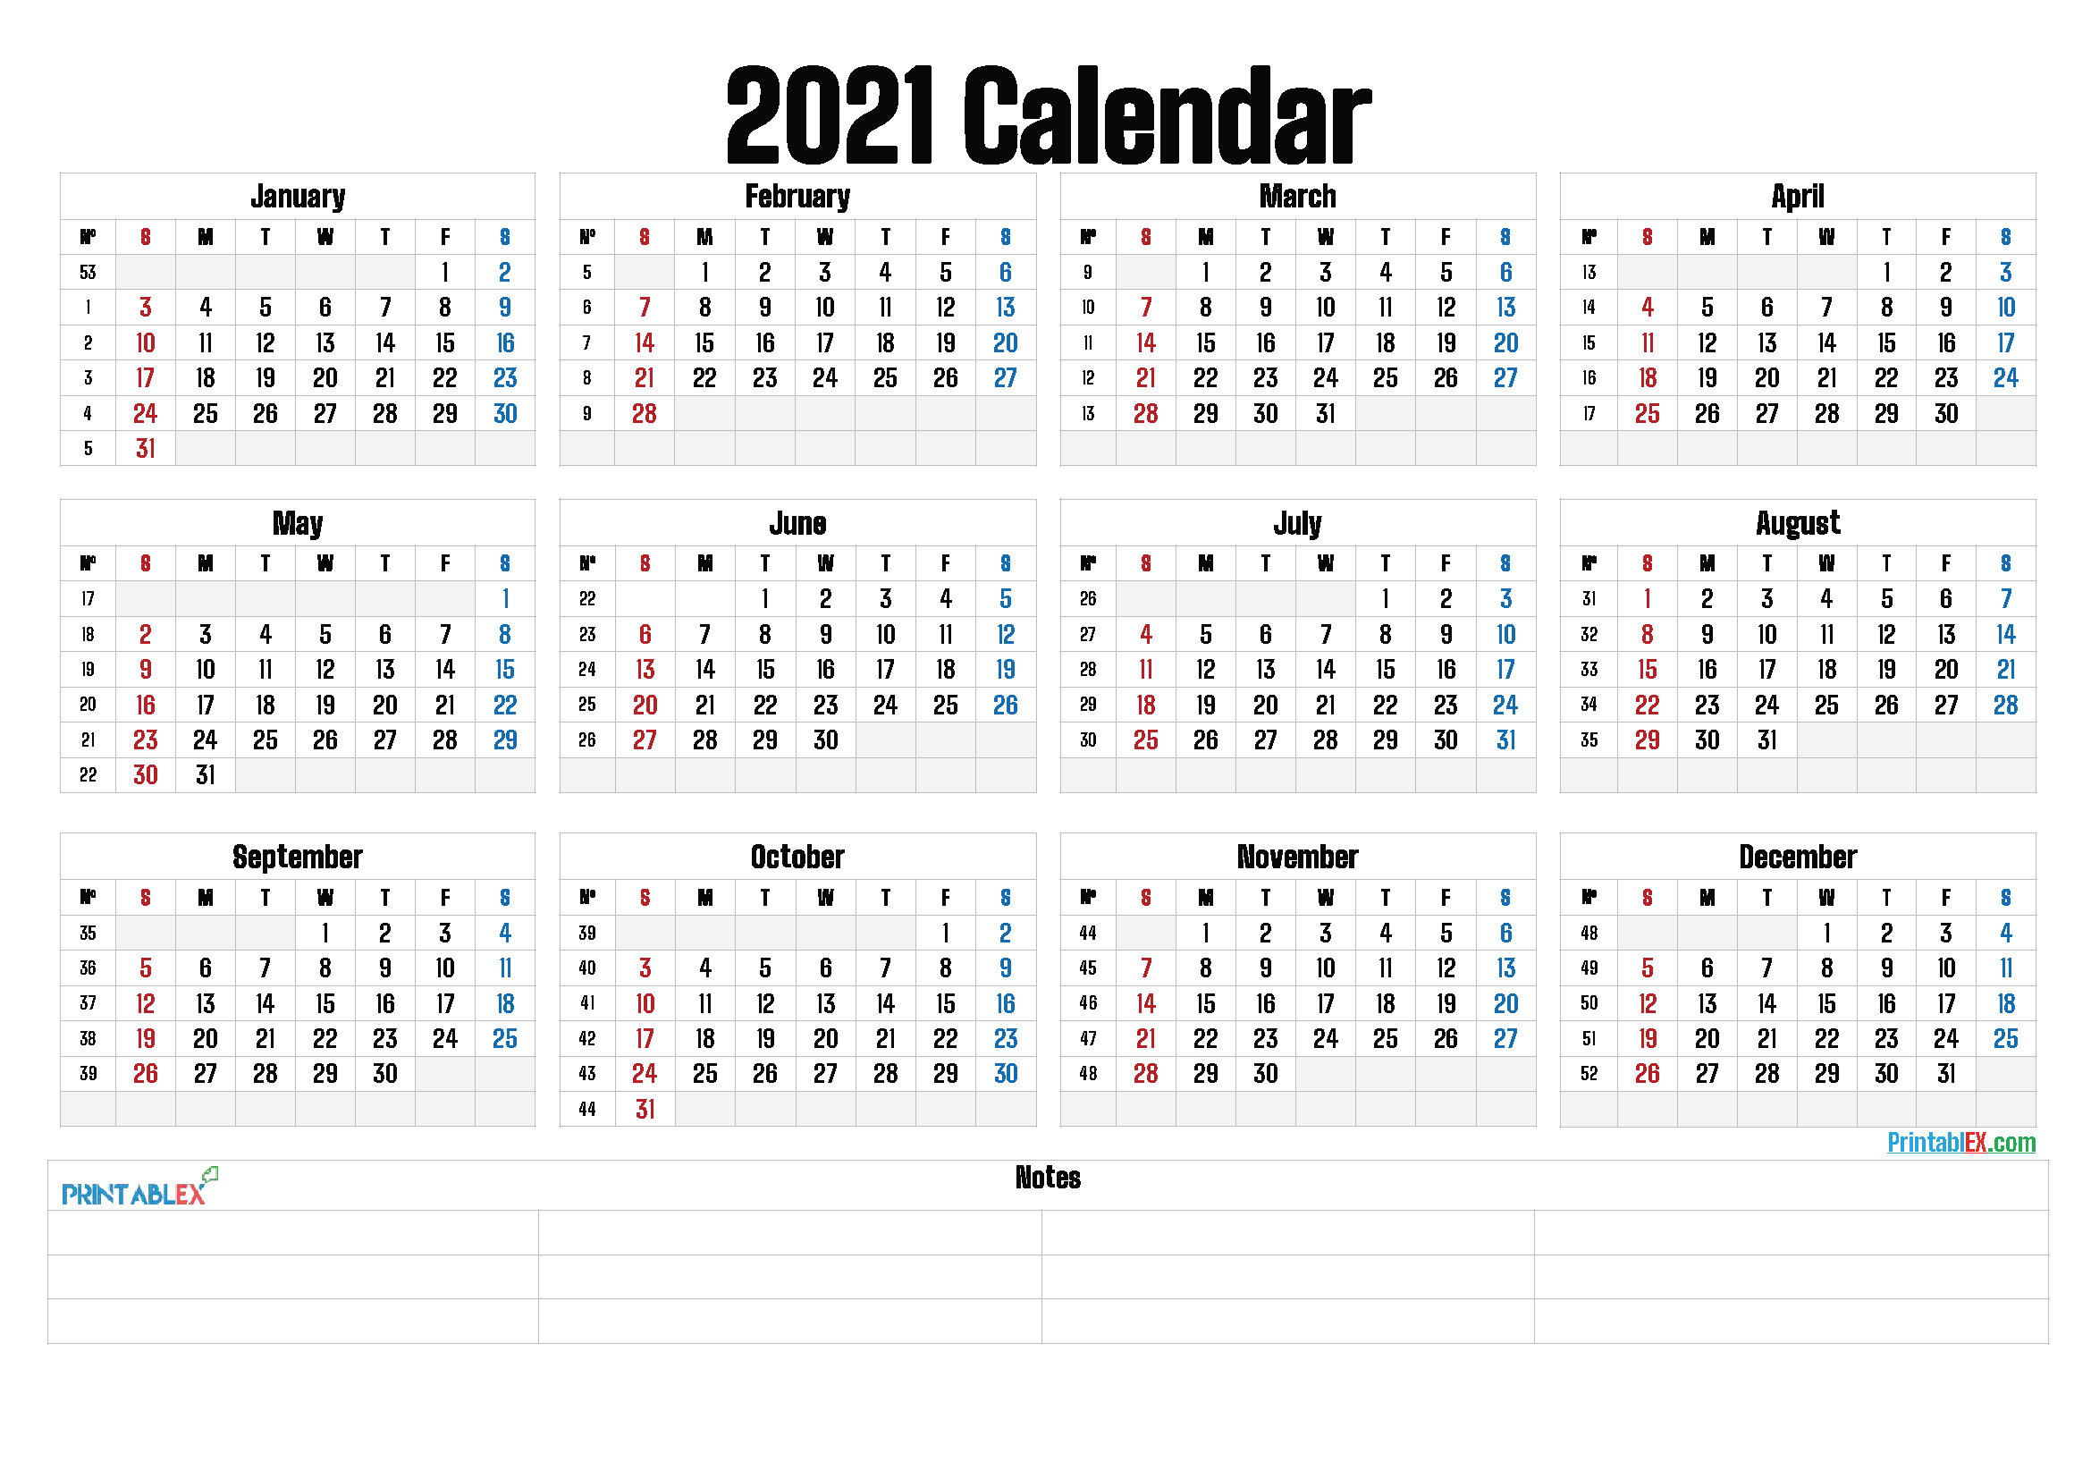

Slide 2
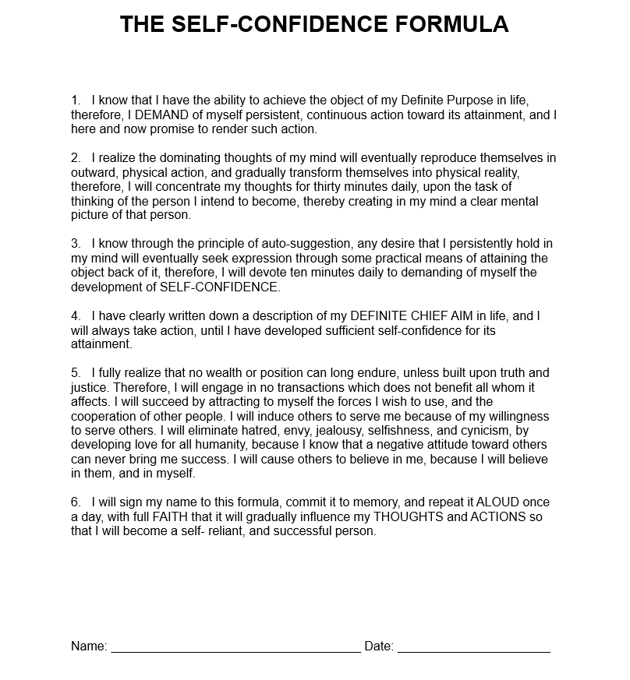
Think and Grow Rich
Napoleon Hill
Words Have Power
If you abide in Me, and My words abide in you, you will ask what you desire, and it shall be done for you.
John 15:7

Slide 3




MY TREE OF LIFE
You 2
You 1
You 3

Slide 4
MY TREE OF LIFE
Prosper
Season
You 2
You 1
Truth 1
Honesty 1
Truth 2
Truth 3
Honesty 2
Honesty 3
You 2
You 3
Love 1
Joy 1
Kindness 1
Faithfulness 1
Peace 1
Patience 1
Goodness 1
Gentleness 1
Truth 1
Honesty 1
Wisdom 1
Lovely 1
You 3
Wisdom 1
Lovely 1
Truth 2
Honesty 2
Wisdom 2
Lovely 2
Wisdom 2
Wisdom 3
Lovely 2
Lovely 3
Truth 3
Honesty 3
Wisdom 3
Lovely 3
Virtue 1
Blessing 1
Passion 1
Covenant 1
Praise 1
Legacy 1
Freedom 1
Endurance 1

Slide 5


THE GATHERING
Prosper
Season
You 2
$480 HARVEST
You 1
$20 x 8 = $160
$40 x 4 = $160
Truth 1
Honesty 1
Truth 2
Truth 3
Honesty 2
Honesty 3
You 2
You 3
$20
$20
$20
$20
$20
$20
$20
$20
$20
$20
$20
$20
You 3
$20 x 8 = $160
Wisdom 1
Lovely 1
$20
$20
$20
$20
Wisdom 2
Wisdom 3
Lovely 2
Lovely 3
$20
$20
$20
$20
$20
$20
$20
$20
$20
$20
$20
$20

Slide 6

Slide 1
The Gathering
One Time Initial Sow & Reap
$20 – Each Support System
$60 – Three Support Systems
$160 – Harvest Tree 1
$320 – Harvest Tree 2&3
$480 – Harvest Total
$300 – Gate Sow
$180 – Total Keep
Sponsor Forward
$60 x 4 = $240
$60 – Yourself
$240 – Four Referrals
$300 – Total

Slide 7
Slide 1
HGS (HOLY GHOST SPOT) GUIDELINES:
If you just sowed your seed or you are in the sow process presently, you will have 3.5 weeks to invite your four PEOPLE to BCE. If you do not have your four PEOPLE by the 3.5 week deadline, you will then need to support the number of missing PEOPLE in HGS Spots. You will then have 6 months to invite your other needed PEOPLE to BCE.
If you still have not satisfied your four PEOPLE requirement, after the 6 months have expired, you will then be required to double HGS Spots.
HGS Request Form - https://bit.ly/HGSREQUEST

Slide 8
SOWING & REAPING SCHEDULE
Example | Gathering 1 Saturday PROSPER | Gathering 2&3 Saturday SEASON | Gate 1 Saturday PROSPER | Garden 1 Sunday PROSPER | Promise 1 Sunday PROSPER | Gate 2 & 3 Saturday SEASON | Garden 2 & 3 Sunday SEASON | Promise 2 & 3 Sunday SEASON | TOTAL KEEP | TOTAL
2/19/22 Sat Join Date | Dep $60 Sow $20
2/26/22 Sat 1 weeks | Reap $160 | Sow $40
2/27/22 Sun
3/5/22 Sat 2 weeks |  | Reap $320 | Sow $100 |  |  | Sow $200 |  |  | $180 | $180
3/6/22 Sun
3/12/22 Sat 3 weeks |  |  | Reap $800 Resow $100 |  |  |  |  |  | $120 | $300
3/13/22 Sun 3 ½ wks-Wed 4 ppl or HGS |  |  |  | Sow $500
3/19/22 Sat 4 weeks |  |  |  |  |  | Reap $1600 Resow $200 |  |  | $240 | $540
3/20/22 Sun |  |  |  |  |  |  | Sow $1000
3/26/22 Sat 5 weeks |  |  | Reap $800 Resow $100 |  |  | Reap $1600 Resow $200 |  |  | $1860 | $2400
3/27/22 Sun |  |  |  | Reap $4000 Resow $500 |  |  | Reap $8000 Resow $1000 Crypto $1100 (Optional) |  | $9300 $8200 w/crypto | $11,700
THE GATHERING – ONE TIME
$480 – ($160+$320) Harvest
$300 – Sow in The Gate
$180 – Keep
GATE - SATURDAY
$800 – Harvest
$80 – 10%
$500 – Sow in Garden
$100 – Re-sow in Gate
$120 – Keep 1st Cycle
$620 – Keep Perpetual
GARDEN - SUNDAY
$4,000 – Harvest
$400 – 10%
$2,500 – Sow in The Promise
$500 – Re-sow in Garden
$600 – Keep 2nd Cycle
$3,100 – Keep Perpetual
THE PROMISE - SUNDAY
$20,000 – Harvest
$2,000 – 10%
$2,500 – Re-sow in The Promise
$15,500 – Keep Perpetual
The Formula
*Week 1 -Tree 1 Reap Harvest
*Week 2 - Tree 2&3 Reap Harvest
*Week 3 - All Trees Reap Harvest

Slide 9
SOWING & REAPING SCHEDULE
 | Gathering 1 Saturday PROSPER | Gathering 2&3 Saturday SEASON | Gate 1 Saturday PROSPER | Garden 1 Sunday PROSPER | Promise 1 Sunday PROSPER | Gate 2 & 3 Saturday SEASON | Garden 2 & 3 Sunday SEASON | Promise 2 & 3 Sunday SEASON | TOTAL KEEP | TOTAL
4/2/22 Sat 6 weeks |  |  | Reap $800 Resow $100 |  |  |  |  |  | $620 | $12,320
4/3/22 Sun |  |  |  | Reap $4000 Resow $500 | Sow $2500 |  |  |  | $600 | $12,920
4/9/22 Sat 7 weeks |  |  |  |  |  | Reap $1600 Resow $200 |  |  | $1240 | $14,160
4/10/22 Sun |  |  |  |  |  |  | Reap $8000 Resow $1000 | Sow $5000 | $1200 | $15,360
4/16/22 Sat 8 weeks |  |  | Reap $800 Resow $100 |  |  | Reap $1600 Resow $200 |  |  | $1860 | $17,220
4/17/22 Sun |  |  |  | Reap $4000 Resow $500 | Reap $20000 Resow $2500 |  | Reap $8000 Resow $1000 | Reap $40000 Resow $5000 | $53,800 | $71,020
4/23/22 Sat 9 weeks |  |  | Reap $800 Resow $100 |  |  |  |  |  | $620 | $71,640
4/24/22 Sun |  |  |  | Reap $4000 Resow $500 | Reap $20000 Resow $2500 |  |  |  | $18,600 | $90,240
4/30/22 Sat 10 weeks |  |  |  |  |  | Reap $1600 Resow $200 |  |  | $1240 | $91,480
5/1/22 Sun |  |  |  |  |  |  | Reap $8000 Resow $1000 | Reap $40000 Resow $5000 | $37,200 | $128,680
5/7/22 Sat 11 weeks |  |  | Reap $800 Resow $100 |  |  | Reap $1600 Resow $200 |  |  | $1860 | $130,540
GATE - SATURDAY
$800 – Harvest
$80 – 10%
$500 – Sow in Garden
$100 – Re-sow in Gate
$620 – Keep Perpetual
GARDEN - SUNDAY
$4,000 – Harvest
$400 – 10%
$2,500 – Sow in The Promise
$500 – Re-sow in Garden
$600 – Keep 2nd Cycle
$3,100 – Keep Perpetual
THE PROMISE - SUNDAY
$20,000 – Harvest
$2,000 – 10%
$2,500 – Re-sow in The Promise
$15,500 – Keep Perpetual
The Formula
*Week 1 -Tree 1 Reap Harvest
*Week 2 - Tree 2&3 Reap Harvest
*Week 3 - All Trees Reap Harvest

Slide 10
SOWING & REAPING SCHEDULE
 | Gathering 1 Saturday PROSPER | Gathering 2&3 Saturday SEASON | Gate 1 Saturday PROSPER | Garden 1 Sunday PROSPER | Promise 1 Sunday PROSPER | Gate 2 & 3 Saturday SEASON | Garden 2 & 3 Sunday SEASON | Promise 2 & 3 Sunday SEASON | TOTAL KEEP | TOTAL
5/8/22 Sun |  |  |  | Reap $4000 Resow $500 | Reap $20000 Resow $2500 |  | Reap $8000 Resow $1000 | Reap $40000 Resow $5000 | $53,800 | $184,340
5/14/22 Sat 12 weeks |  |  | Reap $800 Resow $100 |  |  |  |  |  | $620 | $184,960
5/15/22 Sun |  |  |  | Reap $4000 Resow $500 | Reap $20000 Resow $2500 |  |  |  | $18,600 | $203,560
5/21/22 Sat 13 weeks |  |  |  |  |  | Reap $1600 Resow $200 |  |  | $1240 | $204,800
5/22/22 Sun |  |  |  |  |  |  | Reap $8000 Resow $1000 | Reap $40000 Resow $5000 | $37,200 | $242,000
5/28/22 Sat 14 weeks |  |  | Reap $800 Resow $100 |  |  | Reap $1600 Resow $200 |  |  | $1860 | $243,860
5/29/22 Sun |  |  |  | Reap $4000 Resow $500 | Reap $20000 Resow $2500 |  | Reap $8000 Resow $1000 | Reap $40000 Resow $5000 | $53,800 | $297,660
6/4/22 Sat 15 weeks |  |  | Reap $800 Resow $100 |  |  |  |  |  | $620 | $298,280
6/5/22 Sun |  |  |  | Reap $4000 Resow $500 | Reap $20000 Resow $2500 |  |  |  | $18,600 | $316,880
6/11/22 Sat 16 weeks |  |  |  |  |  | Reap $1600 Resow $200 |  |  | $1240 | $318,120
6/12/22 Sun |  |  |  |  |  |  | Reap $8000 Resow $1000 | Reap $40000 Resow $5000 | $37,200 | $355,320
GATE - SATURDAY
$800 – Harvest
$80 – 10%
$500 – Sow in Garden
$100 – Re-sow in Gate
$620 – Keep Perpetual
GARDEN - SUNDAY
$4,000 – Harvest
$400 – 10%
$2,500 – Sow in The Promise
$500 – Re-sow in Garden
$600 – Keep 2nd Cycle
$3,100 – Keep Perpetual
THE PROMISE - SUNDAY
$20,000 – Harvest
$2,000 – 10%
$2,500 – Re-sow in The Promise
$15,500 – Keep Perpetual
The Formula
*Week 1 -Tree 1 Reap Harvest
*Week 2 - Tree 2&3 Reap Harvest
*Week 3 - All Trees Reap Harvest

Slide 11
THE GAThering
TRINITY ELITE

Slide 12
YOU 1 - GATHERING HARVEST SCHEDULE
$40 each keep = $160
HARVEST DATE | TRUTH | HONESTY | WISDOM | LOVELY |  |  |  | TOTAL REC’D
 | $40 | $40 | $40 | $40 |  |  |  | $160

Slide 13
YOU 2 - GATHERING HARVEST SCHEDULE
$20 each keep = $160
HARVEST DATE | LOVE | JOY | PEACE | PATIENCE | KINDNESS | GOODNESS | FAITHFULNESS | GENTLENESS | TOTAL REC’D
 | $20 | $20 | $20 | $20 | $20 | $20 | $20 | $20 | $160

Slide 14
YOU 3- GATHERING HARVEST SCHEDULE
$20 each keep = $160
HARVEST DATE | VIRTUE | PRAISE | BLESSING | LEGACY | PASSION | FREEDOM | COVENANT | ENDURANCE | TOTAL REC’D
 | $20 | $20 | $20 | $20 | $20 | $20 | $20 | $20 | $160

Slide 15

THE GATE
TRINITY ELITE

Slide 16
YOU 1 - GATE HARVEST SCHEDULE
$310 each keep = $1240 Total
HARVEST DATE | TRUTH | HONESTY | WISDOM | LOVELY |  |  |  | TOTAL REC’D
 | $310 | $310 | $310 | $310 |  |  |  | $1240

Slide 17
YOU 2 - GATE HARVEST SCHEDULE
$155 each keep = $1240 Total
HARVEST DATE | LOVE | JOY | PEACE | PATIENCE | KINDNESS | GOODNESS | FAITHFULNESS | GENTLENESS | Total Rec’d
 | $155 | $155 | $155 | $155 | $155 | $155 | $155 | $155 | $1240

Slide 18
YOU 3- GATE HARVEST SCHEDULE
$155 each keep = $1240 Total
HARVEST DATE | VIRTUE | PRAISE | BLESSING | LEGACY | PASSION | FREEDOM | COVENANT | ENDURANCE | Total Received
 | $155 | $155 | $155 | $155 | $155 | $155 | $155 | $155 | $1240

Slide 19
THE GARDEN
TRINITY ELITE

Slide 20
YOU 1 - GARDEN HARVEST SCHEDULE
$755 each keep = $3100 Total
$1000 each
HARVEST DATE | TRUTH | HONESTY | WISDOM | LOVELY |  |  |  | Total Received
 | $755 | $755 | $755 | $755 |  |  |  | $3100

Slide 21
YOU 2 - GARDEN HARVEST SCHEDULE
$387.50 each keep = $3100 Total
HARVEST DATE | LOVE | JOY | PEACE | PATIENCE | KINDNESS | GOODNESS | FAITHFULNESS | GENTLENESS | Total Received
 | $387.50 | $387.50 | $387.50 | $387.50 | $387.50 | $387.50 | $387.50 | $387.50 | $3100

Slide 22
YOU 3 - GARDEN HARVEST SCHEDULE
$387.50 each keep = $3100 Total
HARVEST DATE | VIRTUE | PRAISE | BLESSING | LEGACY | PASSION | FREEDOM | COVENANT | ENDURANCE | Total Received
 | $387.50 | $387.50 | $387.50 | $387.50 | $387.50 | $387.50 | $387.50 | $387.50 | $3100

Slide 23

THE promise LAND
TRINITY ELITE

Slide 24
YOU 1 - PROMISE HARVEST SCHEDULE
$3875 each keep = $15,500 Total
$5000 each
HARVEST DATE | TRUTH | HONESTY | WISDOM | LOVELY |  |  |  | Total Received
 | $3875.00 | $3875.00 | $3875.00 | $3875.00 |  |  |  | $15,500

Slide 25
$1937.50 each keep = $15,500 Total
YOU 2 - PROMISE HARVEST SCHEDULE
HARVEST DATE | LOVE | JOY | PEACE | PATIENCE | KINDNESS | GOODNESS | FAITHFULNESS | GENTLENESS | Total Received
 | $1937.50 | $1937.50 | $1937.50 | $1937.50 | $1937.50 | $1937.50 | $1937.50 | $1937.50 | $15,500

Slide 26
$1937.50 each keep = $15,500 Total
YOU 3 - PROMISE HARVEST SCHEDULE
HARVEST DATE | VIRTUE | PRAISE | BLESSING | LEGACY | PASSION | FREEDOM | COVENANT | ENDURANCE | Total Received
 | $1937.50 | $1937.50 | $1937.50 | $1937.50 | $1937.50 | $1937.50 | $1937.50 | $1937.50 | $15,500

