Slide 1
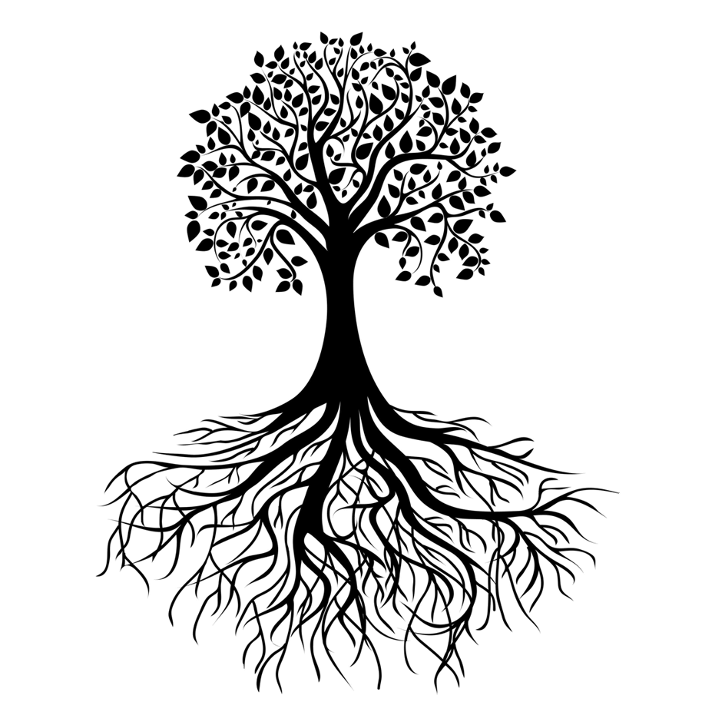


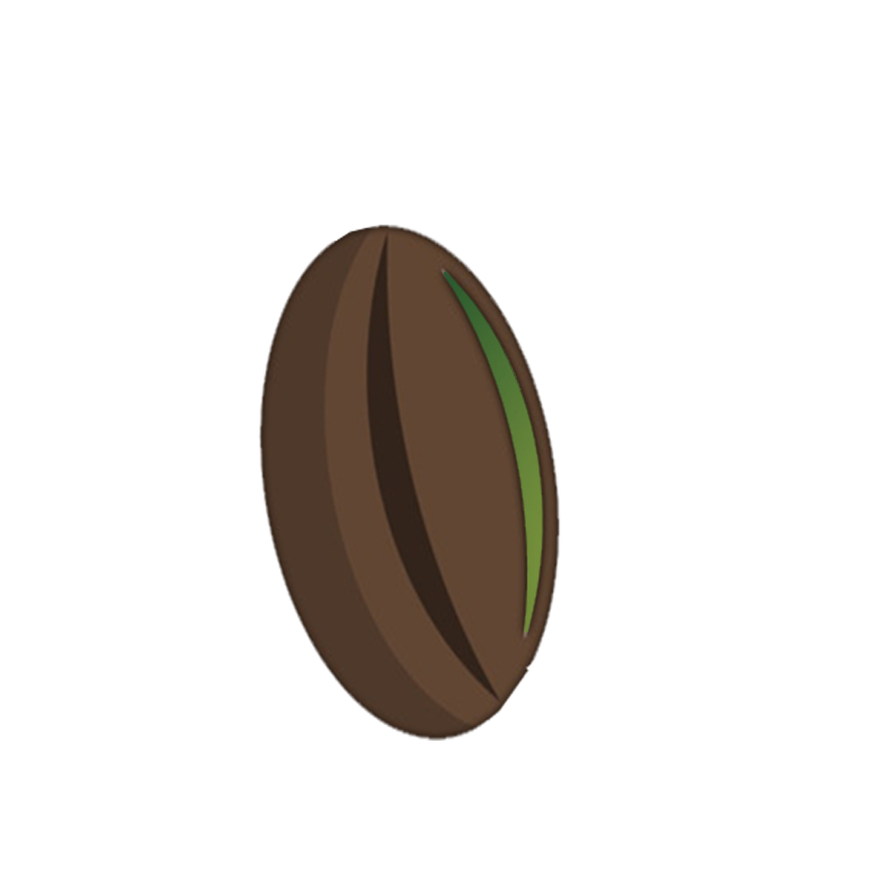
MY TREE OF LIFE
PLANT 1
YOU
PLANT 2

